Slide 1
New management ERA at GBZA
KA1 project aimed at 6 mobilities :
2 structured courses and 4 job-shadowing activities during the project period of 17 months from July 2018 till November 2019
13 614 €

Slide 2
Courses:
Language course – 4 weeks of intensive French at the University of Bretagne Sud in Lorient (headmaster)
Methodology course – 2 weeks in Santander, Spain (deputy head) aimed at coaching in education, mindfulness, neurolinguistics, dealing with conflicts at school, challenges of the 21st century language teaching, innovations in teaching Spanish as ELE

Slide 3
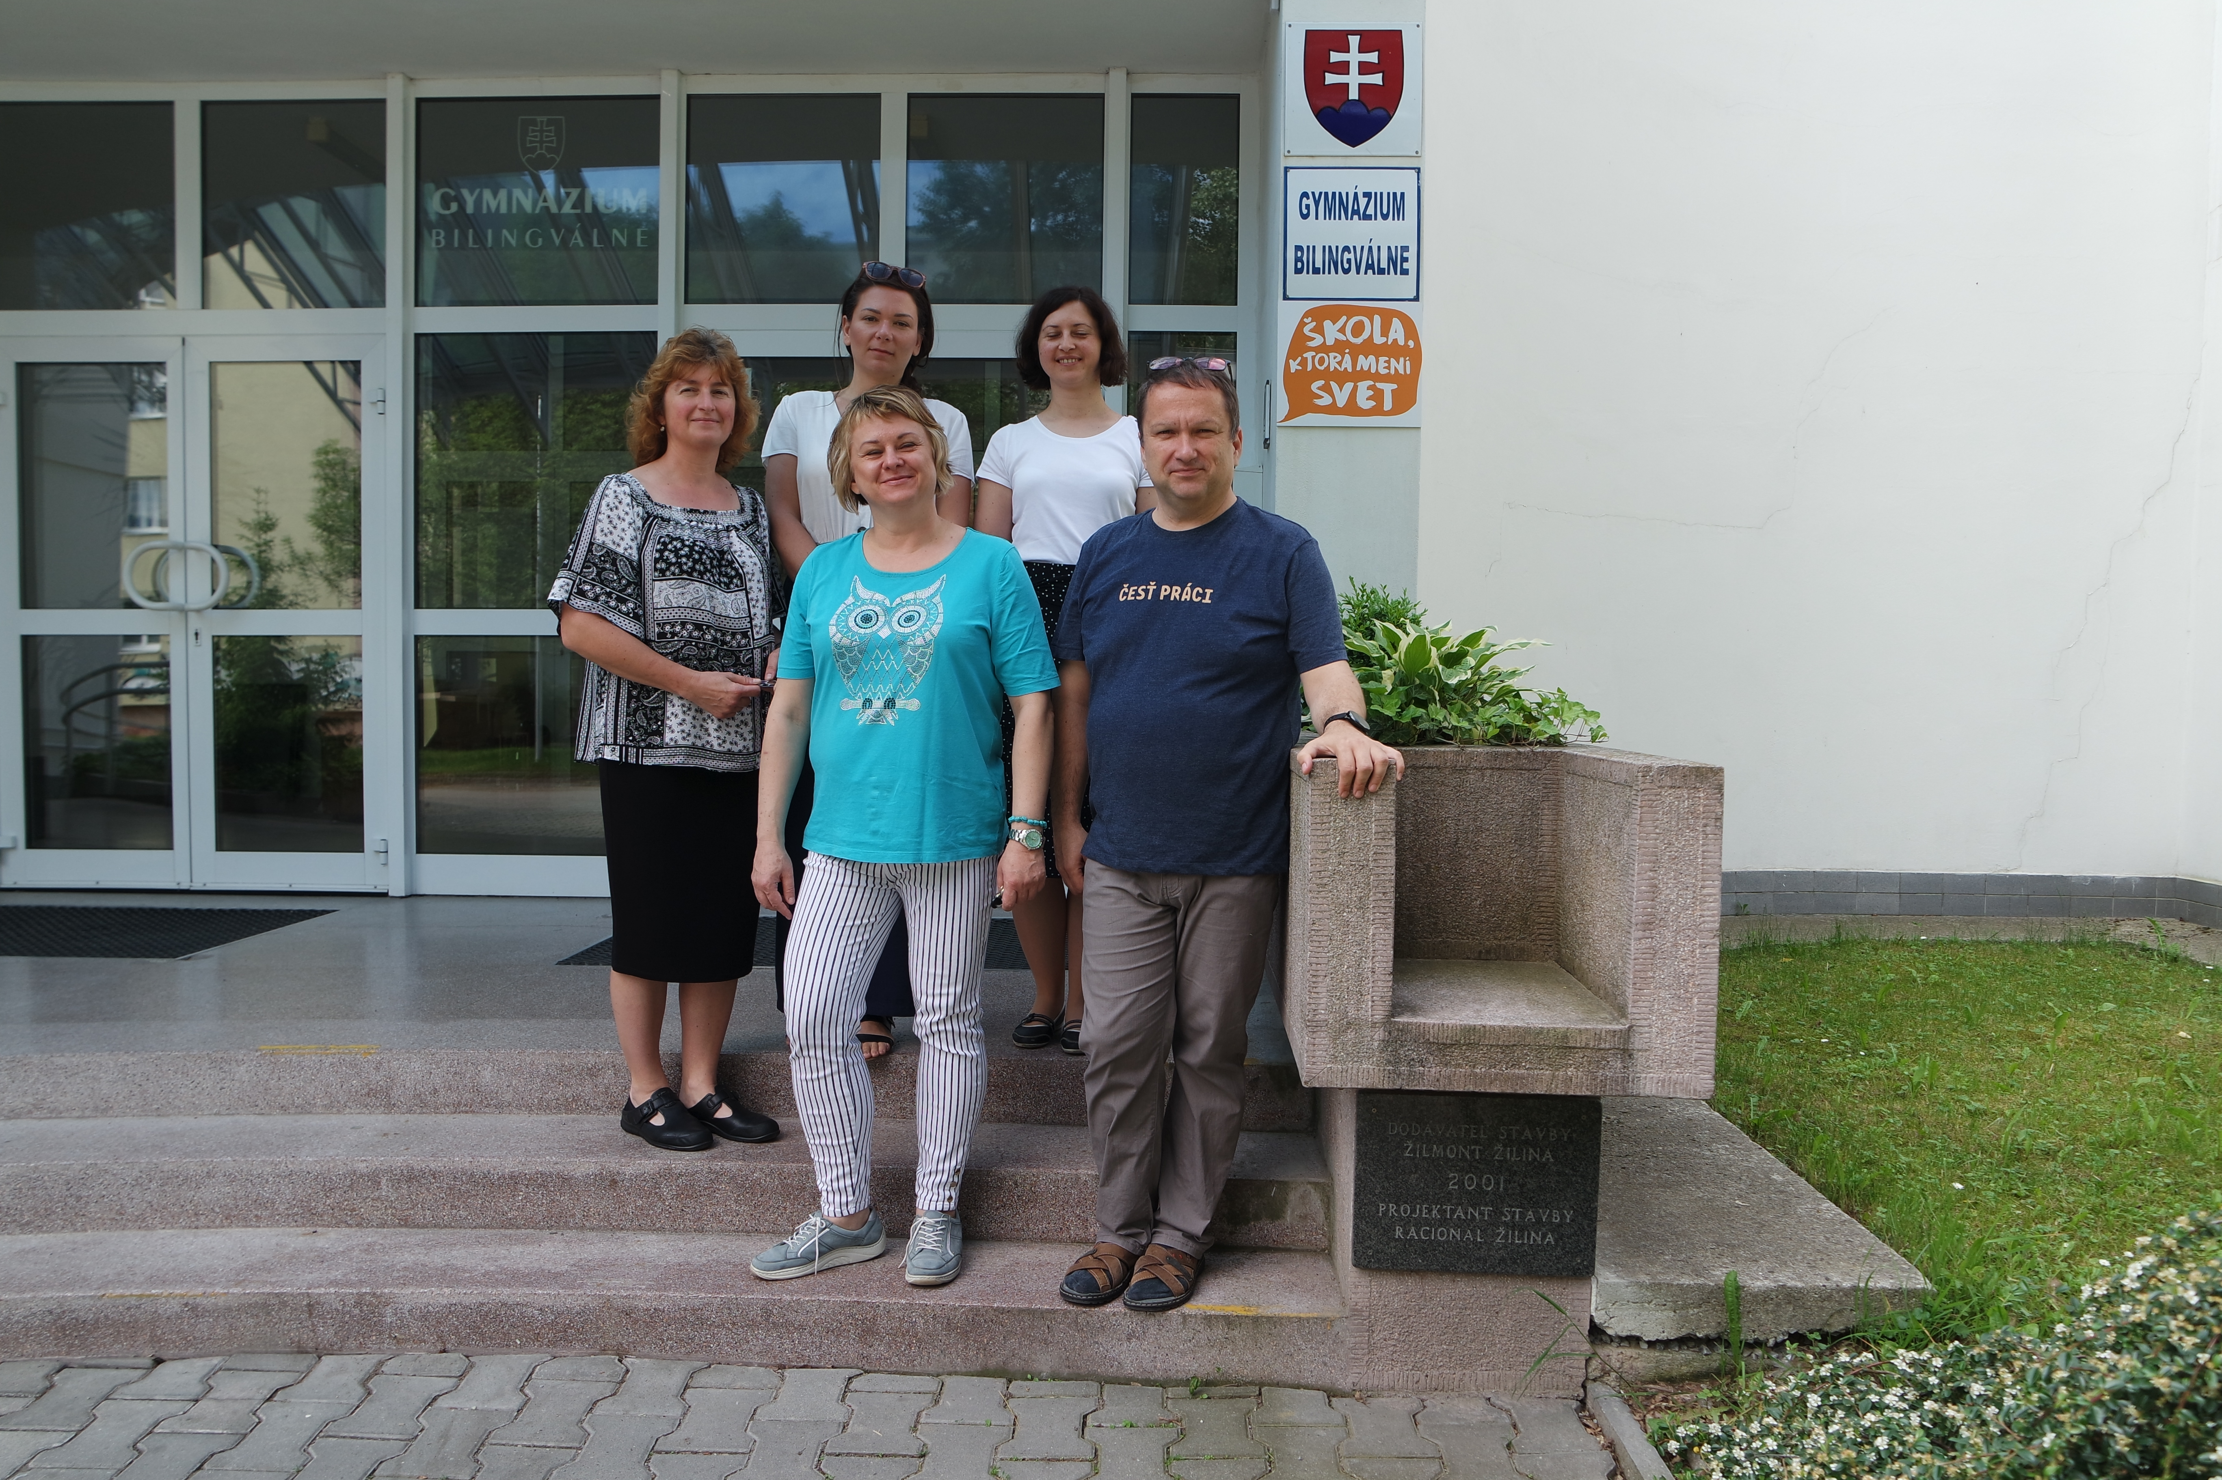
A week job-shadowings:
Finland - Jyväskylä, an English teacher
Luxembourg – head and coordinator attending the annual Europroject conference – MEGALUX 2019
France – 1 language + 1 science teacher
Armentières

Slide 4
Impact
Improved language competences
Implementation of new methods into the lessons (teacher training workshops for dissemination), new ideas into school practice
Students´ exchanges with Schildtin lukio, Jyväskylä and Saint Jude, Armentières
Increased cultural awareness
Deepened international relations and cooperation (new projects, exchanges)

Slide 5
A dissemination group ☺ thank you

